Slide 1
Storyboarding

Slide 2
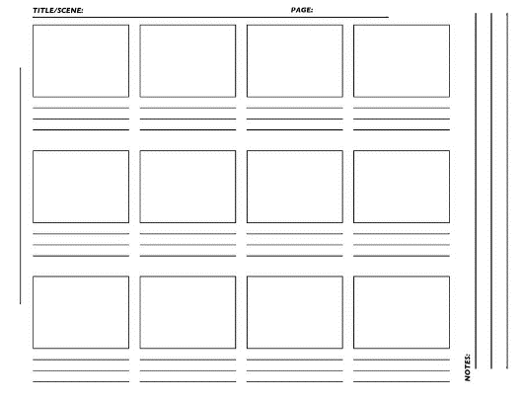
Why should I storyboard?
Planning saves time.
Shares your vision.
Film more effectively.
Edit more effectively.

Slide 3
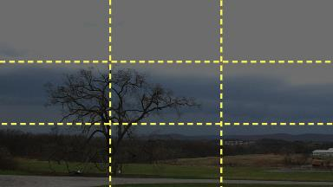
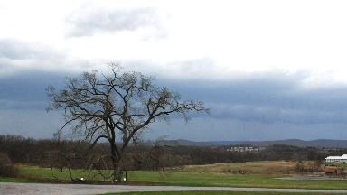
Shot Sizes
Make it easier for the audience to follow the action.
Symbolic meaning.
Use the Rule of Thirds.

Slide 4
Wide Shot (WS)
Give the audience a big look at the location (establishing shot)
Indicate the scope of the location
Imply the character(s) are lost, out of control, or insignificant

Slide 5
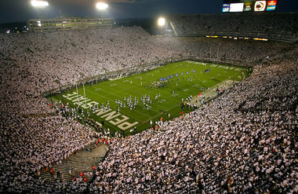
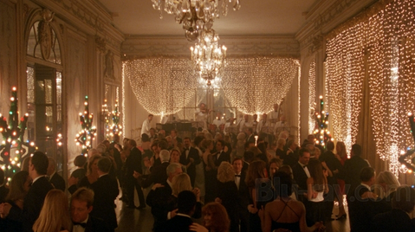
Wide Shot
Notes:
This extreme wide shot of Beaver Stadium not only shows the audience where we are, but also how large it is.
This wide shot of a ballroom lets you familiarize yourself with the location, the ambiance of the room (formal, warm), the nature of the activity happening (a party) and how crowded it is (quite crowded).

Slide 6
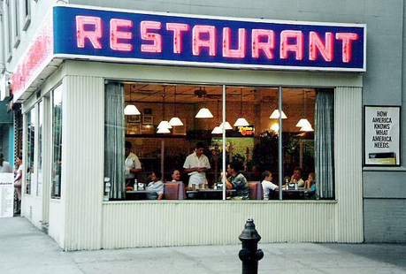
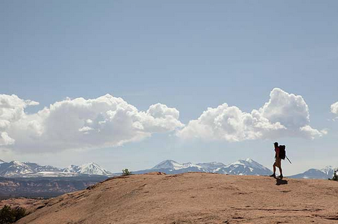
Wide Shot
Notes:
TV shows use establishing shots, like this iconic one from Seinfeld, at the beginning of scenes to let the audience know where the scene is taking place.
This wide shot from 127 Hours shows how insignificant Aron is compared to nature, which is certainly relevant within the context of the plot.

Slide 7
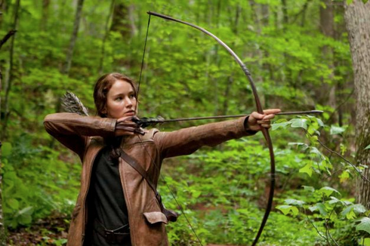
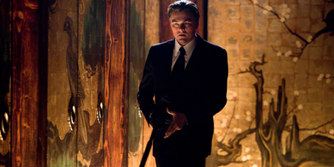
Medium Shot (MS)
Standard, general shot
Used most often
Notes:
This shot allows the audience to get the full scope of what Katniss is doing (shooting an arrow), while also keeping the focus completely on Katniss. Although there is a lot of empty space in this shot, it is clear that Cobb is the subject. It allows the audience to be more familiar with his surroundings as he is moving.

Slide 8
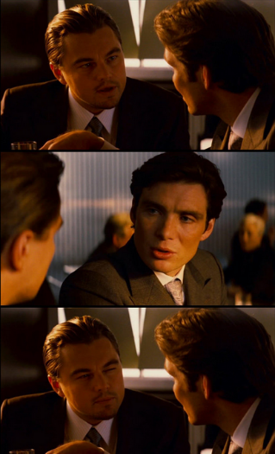
Medium Close-Up
In-between medium shot and a close-up.
Focuses on a particular subject.
Standard shot for face-to-face conversations.
Notes:
This shot size allows the audience to focus solely on the conversation and not be distracted by anything else in the shot. These are also examples of over-the-shoulder shots.

Slide 9
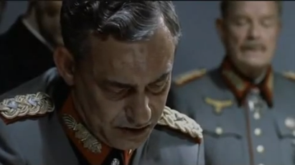
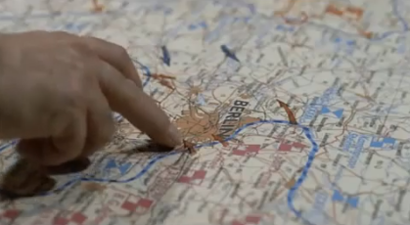
Close-Up (CU)
Draws specific, dramatic attention to an object, character, or space.
Can serve as a cutaway, which is a compliment shot to show what a person is looking at.
Notes:
This close-up focuses on Krebs looking at the map and talking to Hitler. It is close enough to see the stress that he is experiencing.
The close-up/cutaway that follows is a good compliment because now the audience is able to see what he is looking at.

Slide 10
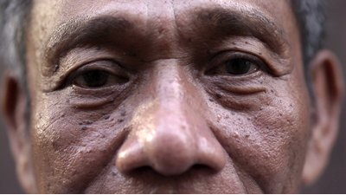
Extreme Close-Up (ECU)
Draws extreme attention to an object, character or space.
Subject fills the entire frame.
Emotional/dramatic effect.
Focuses on details.
Notes:
This extreme close-up highlights the sad, tired emotion in the man’s eyes.
This extreme close-up allows us to see the details of the flower.

Slide 11
Shot Angles
Usually has symbolic significance if it is not an eye-level shot.
All previous examples were eye-level shots, which are neutral.

Slide 12
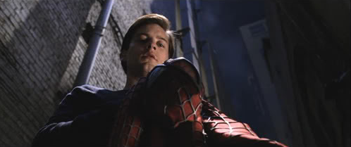
Low Angle
The camera is below the subject facing up.
Implies that the subject is powerful or imposing.
Notes:
This low angle shot of Peter Parker shows that he has obtained power through becoming Spiderman.

Slide 13
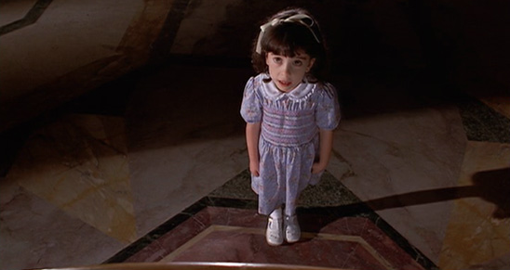
High Angle
The camera is above the subject facing down.
Implies that the subject is powerless or weak.
Notes:
This high angle shot of this little girl shows that she is weak and scared.

Slide 14
Bird’s Eye View
This feels like the audience is observing what’s going on from above.
Conveys a lot of information in one, neutral shot.

Slide 15
Point-of-View
Makes it seem as though the camera is in the same position as the character’s eyes.

Slide 16
The 180° Rule
Notes:
Once you pick a side to film a conversation, visualize an invisible line along the two actors’ eye lines. The camera is not allowed to cross that line. This is so that Actor A on the left is always on the left, and Actor B on the right is always on the right. If you cross the line, suddenly Actor A will be on the left in one shot, and Actor B will also be on the left in another. It will feel wrong to the audience and may disorient them.

Slide 17
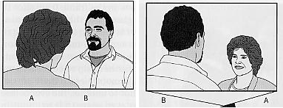
The 180° Rule
Correct:
Incorrect:
Notes:
Once you pick a side to film a conversation, visualize an invisible line along the two actors’ eye lines. The camera is not allowed to cross that line. This is so that Actor A on the left is always on the left, and Actor B on the right is always on the right. If you cross the line, suddenly Actor A will be on the left in one shot, and Actor B will also be on the left in another. It will feel wrong to the audience and may disorient them.

Slide 18
Camera Movement

Slide 19
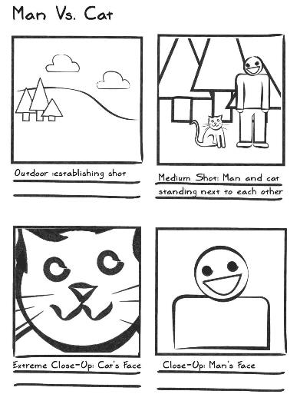
Example Storyboard
Notes:
When creating your storyboard, you need to choose and indicate the content, order, size and angle of your shots, as well as the camera movement. If you will have voiceovers, you can also write down what section of the voiceovers will be heard over which shot.

